Slide 1
© 2018 Cengage Learning®. May not be scanned, copied or duplicated, or posted to a publicly accessible website, in whole or in part.

Slide 2
Marketing Research Tools
15
© 2018 Cengage Learning.® May not be scanned, copied or duplicated, or posted to a publicly accessible website, in whole or in part.

Slide 3
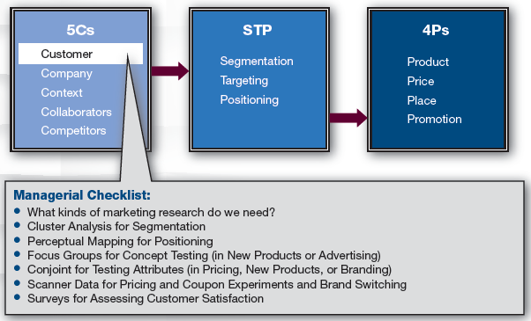
Marketing Framework

Slide 4
Discussion Questions #1
How can you find the answers to the following questions?
How will your targeted customer respond to a price of $7.99 compared to $9.99?
Should you add a new feature that costs $4.00?
Which is a more effective slogan: “We love to see you smile” or “Have it your way”?

Slide 5
Marketing Research
Marketing decisions should be fact-based
Smart marketers are continually gathering market information
Marketers also conduct specific research projects

Slide 6
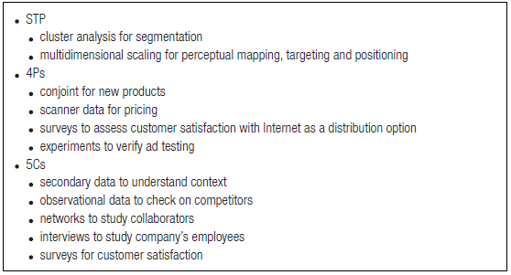
Marketing Research Techniques

Slide 7
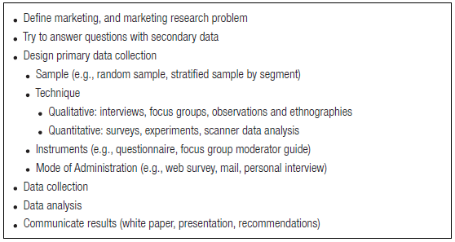
Marketing Research Process

Slide 8
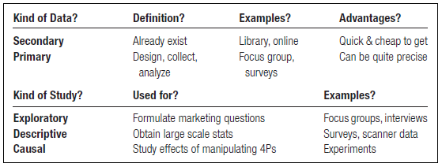
Kinds of Data

Slide 9
Popular Research Techniques
Cluster analysis
Perceptual mapping
Focus groups
Conjoint analysis
Scanner data
Surveys

Slide 10
Cluster Analysis
Clustering
Form groups within groups of customers, who are seeking something similar and different across groups
Each group has different attributes
Often used for segmentation

Slide 11
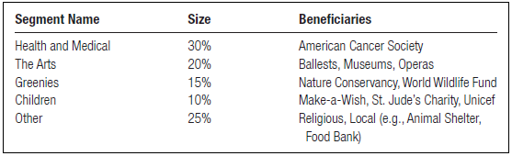
Cluster Analysis Example (slide 1 of 4)
Segmentation of NPO supporters
Desired result: Determine if segment exists that may donate to an NPO that funds higher education
Start with a survey

Slide 12
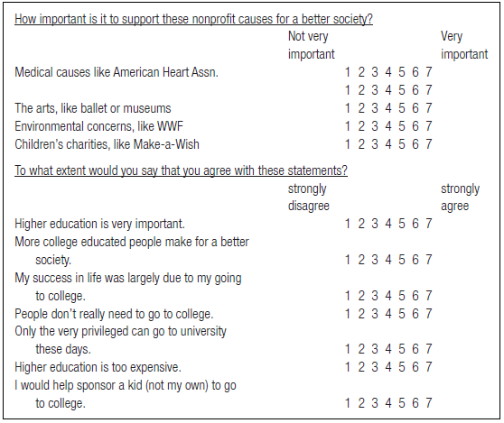
Cluster Analysis Example (slide 2 of 4)
Survey used to interview customers

Slide 13
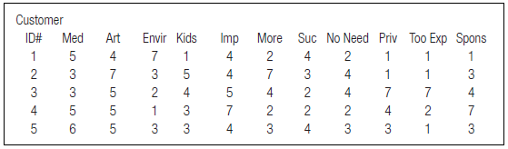
Cluster Analysis Example (slide 3 of 4)
NPO dataset

Slide 14
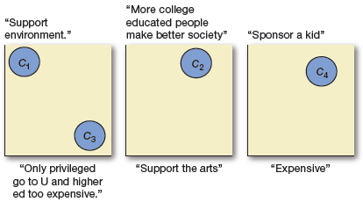
Cluster Analysis Example (slide 4 of 4)
Next, conduct cluster analysis
C1 cares about environment, but not much
C4 cares about medical causes; thinks higher ed is expensive and would support students
C2 cares about the arts; thinks higher ed helps society

Slide 15
Cluster Analysis Questions
Which segment is most attractive for the NPO to target? Why?

Slide 16
Perceptual Mapping
Positioning studies are used to understand customer perceptions of brands in the marketplace
Perceptual maps assist in positioning
They give pictures of competing brands and attributes
Two approaches
Attribute-based approach
Multidimensional scaling (MDS)

Slide 17
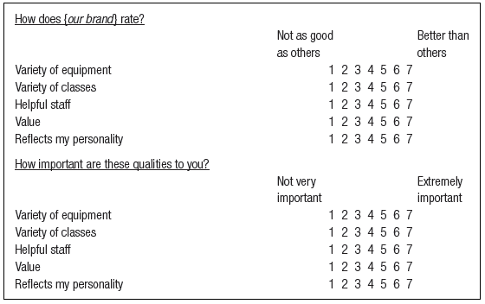
Perceptual Mapping: Attribute-Based (slide 1 of 2)
In attribute-based perceptual mapping
Customers complete a survey

Slide 18
Perceptual Mapping: Attribute-Based (slide 2 of 2)
Responses on each question are averaged
Result is a pair of means for each attribute
e.g., BeFit Gym is perceived as a good value
The pairs of means are used to plot the attributes in a two-dimensional space

Slide 19
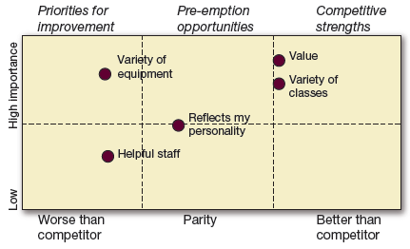
Perceptual Mapping Questions #1
Which attribute is most important?
How does BeFit Gym score on this attribute relative to competitors?
Which attribute should BeFit Gym consider improving? Why?

Slide 20
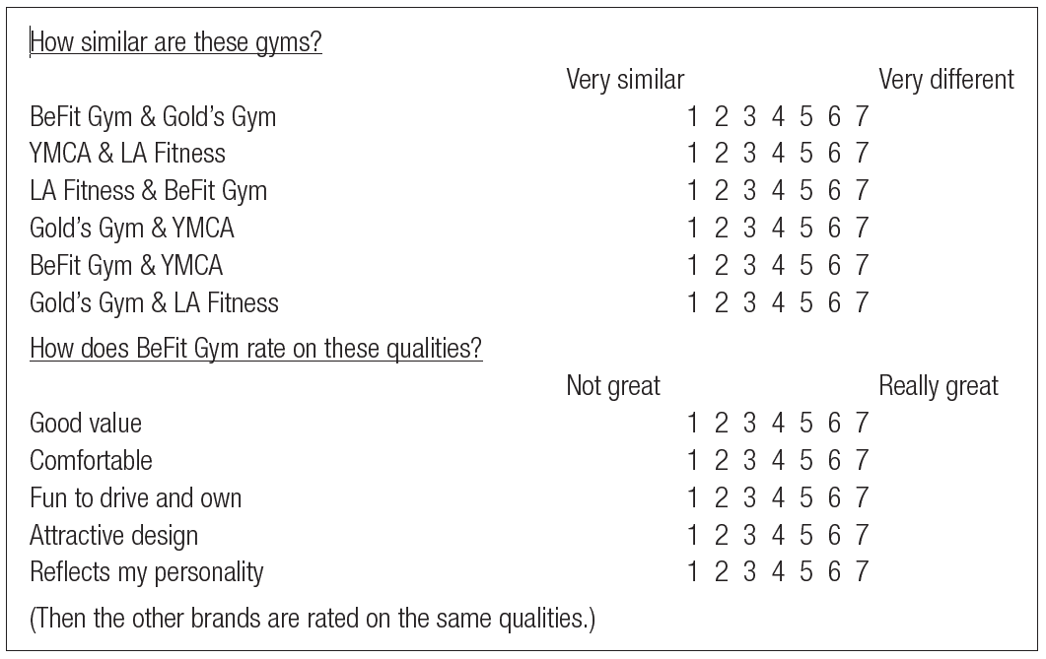
Perceptual Mapping: MDS
Multidimensional scaling starts by asking, “How similar are these two brands?”
Asks for each pair of brands
Then, each brand is rated on attributes

Slide 21
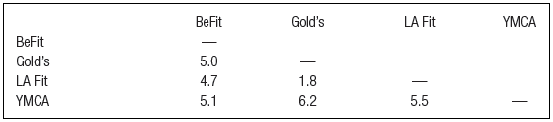
Perceptual Mapping Questions #2
Which brands are viewed as most similar?
Which brand is the most different?

Slide 22
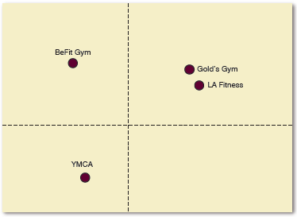
Perceptual Mapping: MDS (slide 1 of 3)
Results are then plotted
Similar brands are closer together; different brands are further apart

Slide 23
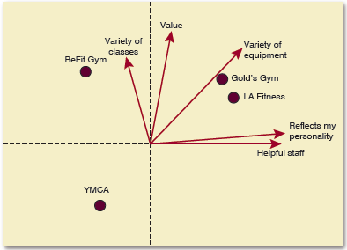
Perceptual Mapping: MDS (slide 2 of 3)
Next, overlay the perceptual map with the attribute ratings

Slide 24
Perceptual Mapping: MDS (slide 3 of 3)
Feature fun classes in ads
Feature staff in ads
MDS can be used to determine how to reposition the brand
Show fun amenities

Slide 25
Focus Groups (slide 1 of 2)
Focus groups
Used for concept testing & ad development
Exploratory technique using 2–4 groups of 8–10 customers
Not good for prediction; best to follow up with a survey
Usually last 1.5–2 hours

Slide 26
Focus Groups (slide 2 of 2)
Focus group moderator
Starts with introductions and easy questions
Proceeds to key client questions
Keeps the discussion going
Brings out quieter members
Controls overbearing members
Moderator usually analyzes results along with company input

Slide 27
Discussion Question #2
Describe at least two research techniques to answer the following objective: How will customers respond to our new packaging?

Slide 28
Conjoint Analysis (slide 1 of 2)
Conjoint studies
Used to understand how consumers make trade-offs
Helps uncover customers’ most important product attributes
Good for pricing, new products, branding, etc.
e.g., Would frequent fliers in a loyalty program want access to an elite club at large airports?

Slide 29
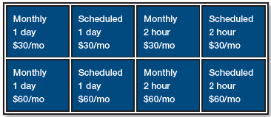
Conjoint Analysis (slide 2 of 2)
Participants rate each option from least to most preferred
What feature do customers want?

Slide 30
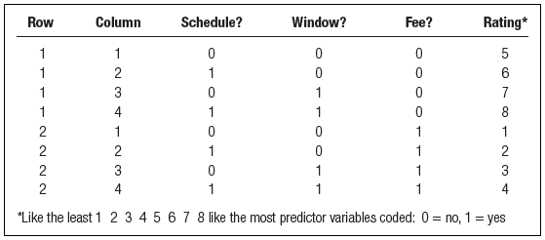
Conjoint Analysis Questions #1
Fliers’ judgments are in the last column
Describe how the customers’ preferred option differs from the 2nd most preferred.
What does this difference mean to marketers?

Slide 31
Conjoint Analysis Questions #2
Regression is run on data with flier ratings as the dependent variable
Predicted rating = 5 + 1 Club + 2 Upgrade – 4 Fee
How would you interpret this?
How would you design your program based on these results?

Slide 32
Scanner Data (slide 1 of 4)
Companies use scanners to track purchase information and store it in a database
Tracked information includes:
What you bought
How much you bought
What brands you bought
How much you paid for everything
Loyalty cards then link this information to each customer

Slide 33
Scanner Data (slide 2 of 4)
Store and area auditors integrate additional information into database
e.g., Prices of competing brands, sales/featured items, advertised brands
Companies can add data from customer panel who provide household information and agree to have their media tracked
These data, with the other tracked data, determine purchase patterns

Slide 34
Scanner Data (slide 3 of 4)
Scanner data can be used to forecast demand and determine responses to marketing changes
Experiments with scanner data
Increase price by X—what happens to sales?
Manipulate independent variable (price); hold all else constant; measure impact on dependent variable (sales)
Compare sales results to control group
High internal validity

Slide 35
Scanner Data (slide 4 of 4)
Naturalistic observation with scanner data
Instead of manipulating environment, just constantly monitor
Things happen that are beyond your control
e.g., Competitors raise price
High external validity
More difficult to attribute sales differences to one localized action
Smart companies do experiments and naturalistic observation

Slide 36
Surveys (slide 1 of 2)
Surveys
Often used to measure customer satisfaction, repurchase intentions, etc.
To administer
Write survey questions
Pretest them
Administer to a sample of customers
Analyze results

Slide 37
Surveys (slide 2 of 2)
Survey considerations
Surveys can be administered in person, over phone, on the Web, etc.
Surveys should be short to enhance response rate
Responses should be confidential
Responses should not be used for subsequent sales opportunities
Respondents can be consumers or B2B

Slide 38
Surveys—Factor Analysis
Factor analysis is utilized to simplify variables
Factor analysis examines strong and weak correlations to identify underlying factors common to the responses
High correlations imply that you may be measuring the same concept

Slide 39
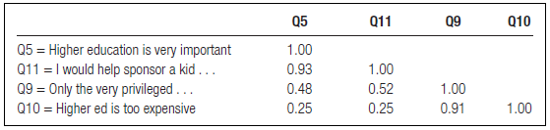
Discussion Question #3
Which items hang together?

Slide 40
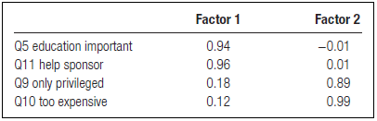
Discussion Questions #4
What would you label Factor 1?
What would you label Factor 2?

Slide 41
Discussion Questions #5
You developed an idea for a new shoe: Having a single shoe sole in which you can clip on different shoe tops to create different shoes (the Onesole).
Describe appropriate research techniques to answer each of the following questions.
Is this concept viable?
Which will generate more sales: one pair of soles and one shoe top for $30, or one pair of shoe soles and 3 shoe tops for $50?

Slide 42
Managerial Recap (slide 1 of 2)
Cluster analysis identifies similar customer groups—ideal for segmentation
Surveys and MDS are used to create perceptual maps—ideal for positioning
Focus groups are exploratory—ideal for product concept and ad testing

Slide 43
Managerial Recap (slide 2 of 2)
Conjoint methods indicate trade-offs—ideal for product design
Scanner data—ideal for investigating brand switching, loyalty, price sensitivity, and marketing experiments
Surveys—ideal for satisfaction
Can be simplified through factor analysis

